Slide 1
Category review: Chips
August 2022
Retail Analytics
Brand note: If client logo is not required, use alternate title page layout right click slide thumbnail > Layout > Title

Slide 2
Notes:
To view Privacy video explaining how important data privacy is to Quantium, please click here: https://www.youtube.com/watch?v=Zq1QDAkoRzU
or here Q:\Company Reference\Brand & Design\Brand videos\Q Privacy.mp4
At Quantium, we believe that data is the behavioural footprint of humanity and that it has to be treated with the utmost care and responsibility.
Histories, attitudes, indeed lives are stored within it in ways that aren’t always apparent – and that’s what makes its potential so powerful.
To work with it responsibly, sensitively, we set ourselves the highest data privacy protection and governance standards.
We have spent 17 years perfecting privacy-by-design and secure-by-design principles. Central to this is not holding any personally identifiable information about people –
we neither receive it, and put the necessary protections in place to be unable to decipher it.
Every aspect of handling data is safeguarded: from its de-identification, to its encryption – data security is paramount and of the highest grade.
We pride ourselves on gaining the trust of iconic organisations around the world through years of securely working with their data,
and in turn the trust that builds with their stakeholders.

Slide 3
Executive summary
In month of December there was unusual high sales prior to Christmas.
Maximum number of transactions are for the brand KETTLE.
Total Sales are highest for Budget - older families, Mainstream - young singles/couples, and Mainstream - retirees shoppers.
Mainstream Mid-age and Young Singles/Couples pay more per packet of chips.
Mainstream young singles and couples are more likely to purchase Tyrrells chips.
Packet size of "270g" which is only provided by the brand “Twisties“ is preferred more.
01
Task 1
Trail Stores 77 and 88 showed significant increase in Total Sales and Number of Customers during trial period.
Trail Store 86 also increased but insignificant compared to its Control store.
02
Task 2

Slide 4
01
Category

Slide 5
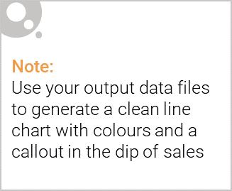
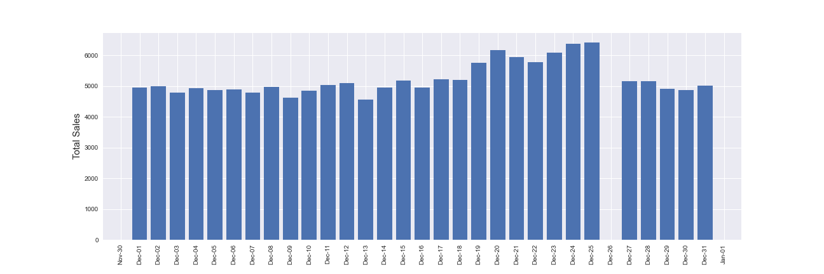
Sales increase steadily as the Christmas day approaches.
The day with no transaction is a day after Christmas day that is when the store is closed.

Slide 6

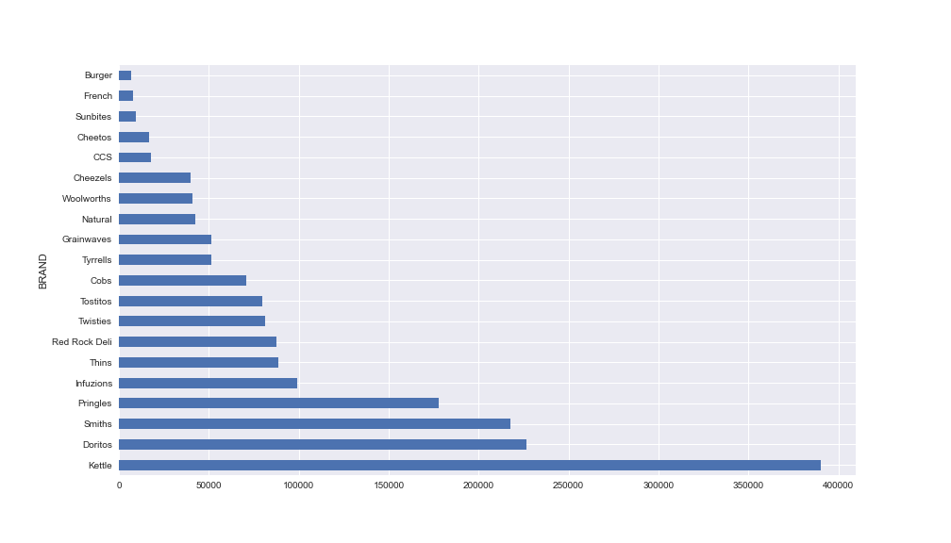
Brand “KETTLE” has the highest total sales among the other brands.

Slide 7
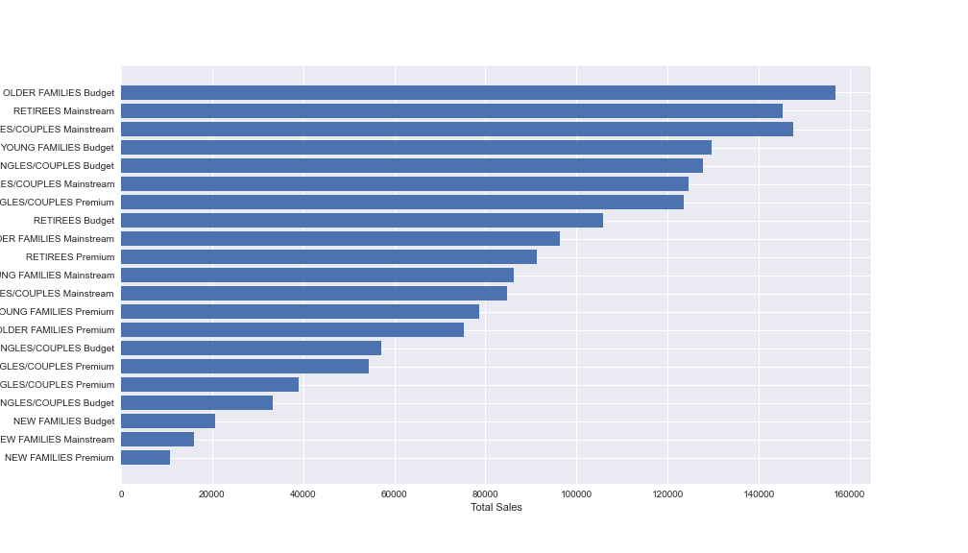
Sales mainly came from Budget - Older Families, Mainstream – Young Singles/Couples, and Mainstream - Retirees.
In total, older customers buy more than younger customers.

Slide 8
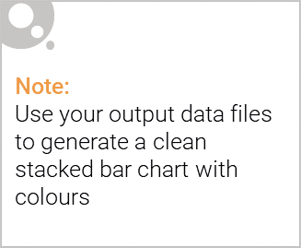
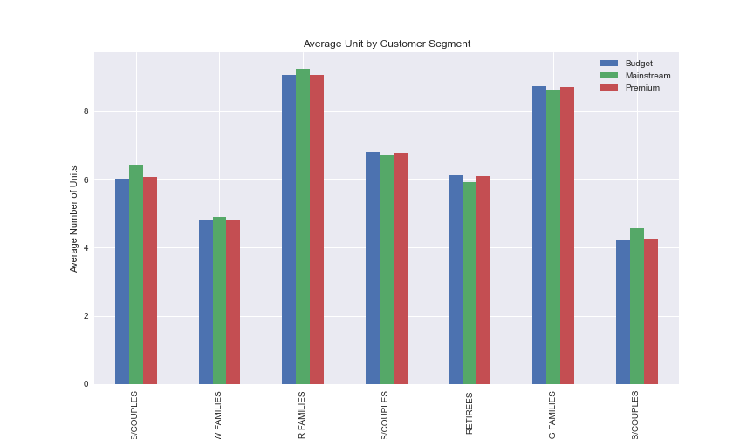
Editable (delete this)
Older and Young Family segment have the highest average purchase units per unique customer

Slide 9
02
Trial store performance

Slide 10
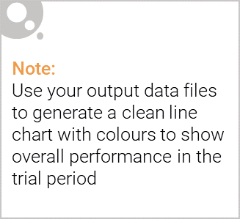
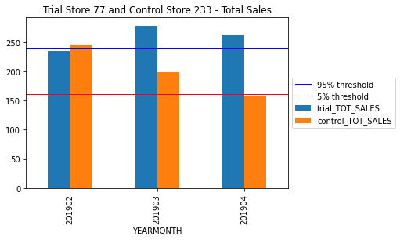
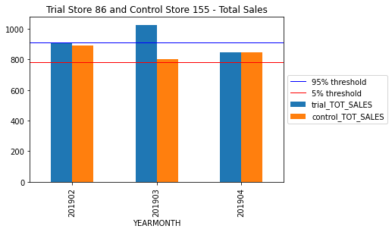
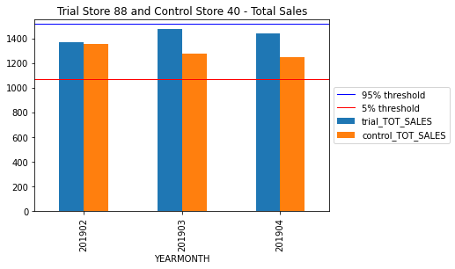
Trial store 77 sales for March and April and Trail store 86 sales for March had significant higher sales than control store.
Trail store 88 sales increase is insignificant.

Slide 11
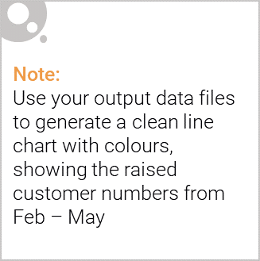
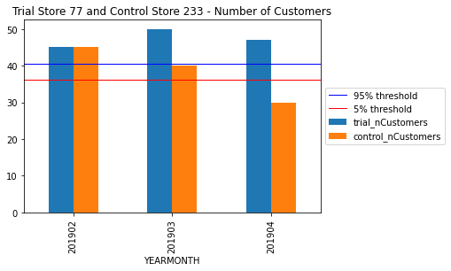
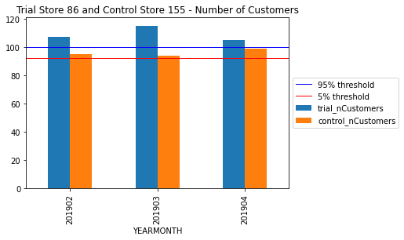
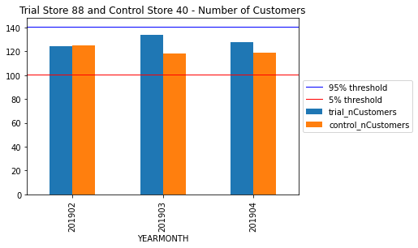
Trial store 77 and 86 for Feb, March, and April has significant increase in number of customers than control store.
Trail store 88 customers increase is insignificant.

